Slide 1
2020 ADL Customers CRD Summary Report
Stop
Customers confidential information under NDA, Intel internal use only
Rev1.2, CQ&R CMEE Team, 2020Q4

Slide 2

General SMT Line Layout
Post-Reflow Automated Optical Inspection (AOI)
Pre-Reflow Automated Optical Inspection (AOI) - Optional
Solder Paste Inspection (SPI)

Slide 3
Objectives
Share Findings From CMEE Mobile Industry Data Collection (ADL Platform Customer Survey)
Data Collected From 10 ODM Customers/Sites
  Compal (KunSan – Build for Dell/HP, ChengDu – Build for Dell, ChongQing – Build for Acer)
  HuaQin (Build for HuaWei/Asus/Lenovo)
  Inventec ChongQing (Build for HP)
  LCFC (Build for Lenovo)
  MSI KunSan (Own Brand)
  Pegatron (ChongQing – Build for Asus, SuZhou – Build for MSFT/Intel)
  Wistron TaiWan (Build for Lenovo)

Slide 4
Highlights
See increasing usage of Yunnan-Tin and other pastes, ShenMao is reducing the market share in client segment →
More customers capable on 01005 component SMT →
0.35mm pitch BGA acceptance still relatively low (3/10 capable) →
See increased customer adoption of vacuum support block →
Copper-Nickel-Zinc is a quite popular material for EMI shield →
Black SM PCB downgrade AOI performance, SMD pad preferred for small size Pad →
All customers measure O2 PPM at reflow/peak zone →
UV glue is the most common board adhesive, apply after SMT before test →
2mm is the most common KOZ width, different customers have KOZ length →
There are 3 customers are using N2 on rework process →
Black SM cost up 3%~5%, Tg 150 is the most common material →

Slide 5
Solder Paste Printing

Slide 6
Solder Paste Printing (1 Of 5)
What are the top 3 SAC pastes and the percentage of each type used in your production line?
Compal KS | Compal CD | Compal CQ | HuaQin | Inventec CQ
YuanNan Tin YW9-3005-98CY04 (96%) ShenMao PF606-P (2%) YankTai NP01-P101-I+ (2%) | YuanNan Tin YW9-3005-98CY04 (100%) ShenMao PF606-P (0%) * Percentage could be change overtime | YuanNan Tin YW9-3005-98CY04 (90%) ShenMao PF606-P (10%) | Shenmao PF606-P26 SAC305 Type4： 87.5% Shenmao PF606-P245 SAC305 Type4：9.37% INDIUM8.9HF SAC305 Type5-MC：3.13% | Shenmao PF606-P (50%) TamuraTLF204 (40%) Eunow EUP1000 HQR (T5)(10%)
LCFC | MSI | Pega CQ | Pega SZ (JDM1 + Intel SPG & NSG) | Wistron
Shenmao PF606 (70%) * Other 30% is LTS paste | KOKI M406-3 | ShenMao PF606-P YunNan Tin YW9-3005-98US04, Type-4, SAC305 * US04: YunNan Tin customized for Pegatron/Asus only | Intel NUC: DW-1000，SSD: PF606-P25 1.Eunow LTS DW-1000 2.Shenmao PF606-P26&PF606-P 3. Senju S70G&M705-S101HF(N4) 4.Indium 8.9HFA Type 4.5 | SAC305, SAC105
Seeing Trend Of Reduction Of ShenMao And Increasing Of YunNan Tin

Slide 7
Solder Paste Printing (2 Of 5)
What is the Stencil Thickness Range (mm) used for different package pitch?
Compal KS | Compal CD | Compal CQ | HuaQin | Inventec CQ
0.4mm: 3mil 0.5~0.6mm: 4~5mil | 0.4~0.5mm: 4mil | 0.65mm: 5mil | 4mil – 5mil | 0.35mm: 3mil others: 4~5mil
LCFC | MSI | Pega CQ | Pega SZ (JDM1 + Intel SPG & NSG) | Wistron
0.35~0.5mm :3mil >=0.65mm: 4mil or 5mil | 0.5~0.6mm: 4mil 0.7mm: 5mil | 0.4mm: 3mil 0.6mm: 4mil | 0.35mm-3mil 0.4mm-3mil/4mil 0.5mm-4mil 0.6mm-5mil | 3mil ~ 5mil
If 01005 component size is used on ADL-M platform, is your mfg. line qualified for HVM assembly?
Compal KS | Compal CD | Compal CQ | HuaQin | Inventec CQ
Yes | No | No | Yes, already in HVM | Yes
LCFC | MSI | Pega CQ | Pega SZ (JDM1 + Intel SPG&NSG) | Wistron
Yes, so far less than 20Pcs per panel | No | No | Machine capable, no real HVM yet | Yes
3 Mil For 0.35~0.4 Pitch BGA, 4~5 Mil For 0.5~0.7mm Pitch BGA
6/10 Customers Have 01005 Capability

Slide 8
Solder Paste Printing (3 Of 5)
Do your require Intel to provide 3mil a stencil recommendation for U-Series CPU? If yes, can you specify the reason?
Compal KS | Compal CD | Compal CQ | HuaQin | Inventec CQ
No | Nice to have, future for small pitch connector we may use 3mil stencil | No | No | No
LCFC | MSI | Pega CQ | Pega SZ (JDM1 + Intel SPG & NSG) | Wistron
No, 0.65mm pitch keep use same 4~5mil stencil | No requirement, but nice to have | Nice to have, for fine pitch connector | No | Depends on customer requirement
What is smallest pad to pad separation for 1 mil (25um) step down stencil?
Compal KS | Compal CD | Compal CQ | HuaQin | Inventec CQ
1mm | 0.4mm | NA | 0.5mm | 7.5mm
LCFC | MSI | Pega CQ | Pega SZ (JDM1 + Intel SPG&NSG) | Wistron
0.2mm | 5mm | 5mm | 5mm | Confidential
3mil For U Package Is Not A Major Request Yet
Very Wide Range Of Pad To Pad Gap For Step Stencil

Slide 9
Solder Paste Printing (4 Of 5)
What is the smallest AR (Area Ratio) capable in HVM?
Compal KS | Compal CD | Compal CQ | HuaQin | Inventec CQ
0.6 | 0.68 | 0.66 | 0.66 | 0.55
LCFC | MSI | Pega CQ | Pega SZ (JDM1 + Intel SPG & NSG) | Wistron
0.66 | 0.66 | 0.65 | 0.66 | Confidential
Do you have challenges printing 0.35mm pitch BGAs?
Compal KS | Compal CD | Compal CQ | HuaQin | Inventec CQ
Yes | Yes | Yes | No | Yes
LCFC | MSI | Pega CQ | Pega SZ (JDM1 + Intel SPG&NSG) | Wistron
Yes, need to use whole process pallet | Yes | Yes | No (in using) | No
Most Customers Still Hold 0.66 AR
3/10 Customers Think 0.35 Pitch BGA Is Not A Challenge

Slide 10
Solder Paste Printing (5 Of 5)
Pictures
For Intel SOC board side, and following pcb thicknesses of 0.6, 0.7, 0.8 & 1.0 mm, please state if support pins, print pallets, vacuum fixture, or support block is used for board support.
Compal KS | Compal CD | Compal CQ | HuaQin | Inventec CQ
Vacuum Block | Support block | Support Block | ≤0.8mm：print pallets；>0.8mm： support block | Support Block
LCFC | MSI | Pega CQ | Pega SZ (JDM1 + Intel SPG & NSG) | Wistron
For all thickness, first side use support block, 2nd side use vacuum block | Support Pin | <0.8mm: Whole process pallet >=0.8mm: Support block | Whole process pallet + Support block | Depends
Do you use different board support strategies for different board thicknesses: 0.6, 0.7, 0.8, 1.0 mm?
Compal KS | Compal CD | Compal CQ | HuaQin | Inventec CQ
No | No, all brd are 1.0mm in our site | No | ≤0.8mm：print pallets；>0.8mm： support block | No
LCFC | MSI | Pega CQ | Pega SZ (JDM1 + Intel SPG&NSG) | Wistron
No | All use support Pin | <0.8mm：print pallets；>=0.8mm： support block | All board SOC side use whole process pallet + Support block | Depends
Support Block Still The Mainstream. Vacuum Block Start Appear In Customer Line. Print Pallet Will Be Used For Thin Brd.

Slide 11
Solder Paste Inspection (SPI)

Slide 12
Solder Paste Printing (1 Of 1)
For SPI volume control limits, what is percentage of defects (opens, in-sufficients, bridging) attributed to print volume?
Compal KS | Compal CD | Compal CQ | HuaQin | Inventec CQ
0.03% | No answer | No answer | 0% | 0.3% out of all the failures
LCFC | MSI | Pega CQ | Pega SZ (JDM1 + Intel SPG & NSG) | Wistron
0.08% | near to 0% | No answer | No data | Confidential
What is the typical percentage rate of board wash?
Compal KS | Compal CD | Compal CQ | HuaQin | Inventec CQ
1/2000 | 4/4500 | 2/1500 | 0.11% | 1/1500
LCFC | MSI | Pega CQ | Pega SZ (JDM1 + Intel SPG&NSG) | Wistron
0.25% | near to 0% | near to 0% | Avg 4/1000 | Confidential

Slide 13
Pick and Placement (PnP) Machine

Slide 14
Pick and Placement (PnP) Machine (1 of 2)
State BGA Placement Force in Newtons when Intel component is placed?
Compal KS | Compal CD | Compal CQ | HuaQin | Inventec CQ
2.5N | 2.5N | 2.5N | N/A | N/A
LCFC | MSI | Pega CQ | Pega SZ (JDM1 + Intel SPG & NSG) | Wistron
2.5N | N/A | 0 | NXT: 0 NPM:2.5N | Confidential
For Intel SOC board side, and following pcb thicknesses of 0.6, 0.7, 0.8 & 1.0 mm, please state if placement pallets are used for board support.
Compal KS | Compal CD | Compal CQ | HuaQin | Inventec CQ
No | No | No | No | No (except when use whole proces pallet)
LCFC | MSI | Pega CQ | Pega SZ (JDM1 + Intel SPG&NSG) | Wistron
No | No | No (except when use whole proces pallet) | Whole process pallet | Whole process pallet
Nobody Is Using PnP Pallets Expect When Use Whole Process Pallets

Slide 15
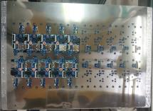
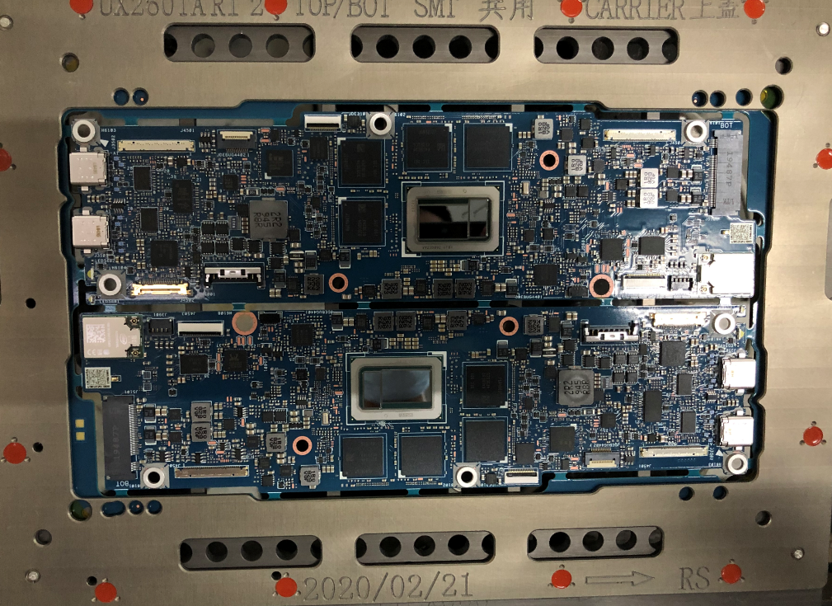
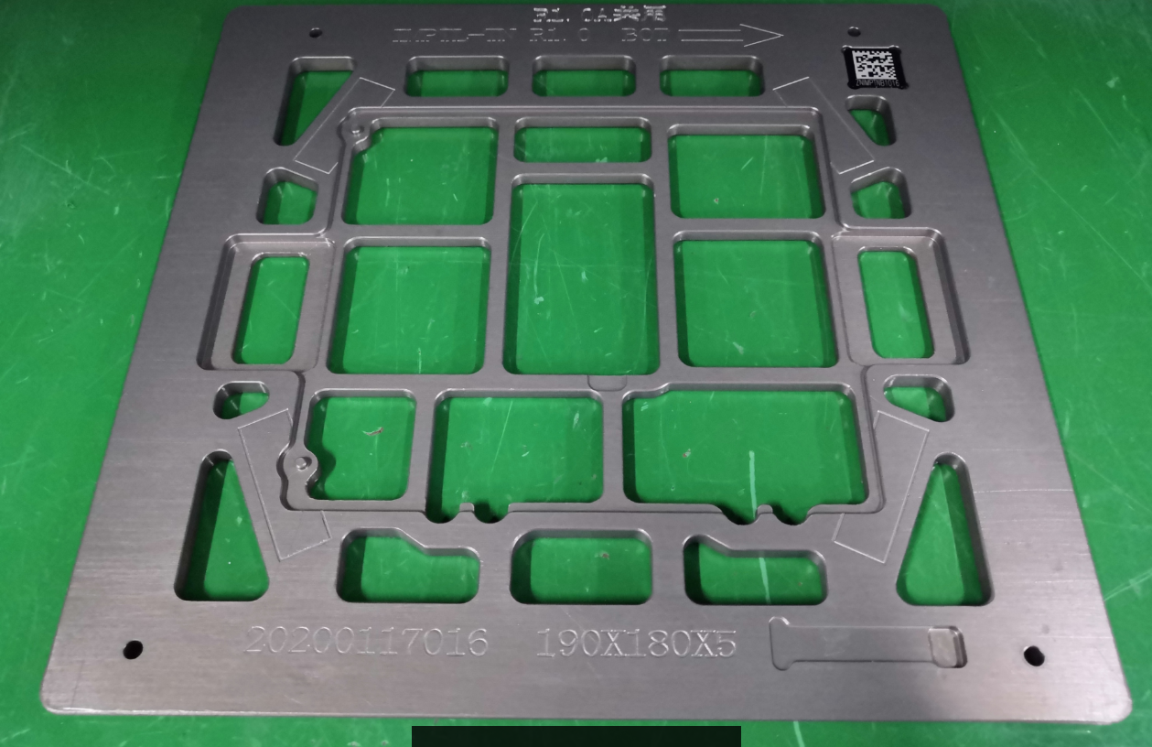
Pick and Placement (PnP) Machine (2 of 2)
Do you use different board support strategies in PnP machine for different board thicknesses: 0.6, 0.7, 0.8, 1.0 mm?
Compal KS | Compal CD | Compal CQ | HuaQin | Inventec CQ
No | Maybe | No answer | <0.8mm, use whole process pallet | PCB = 0.6mm, use whole process pallet PCB > 0.6mm, no pallet
LCFC | MSI | Pega CQ | Pega SZ (JDM1 + Intel SPG & NSG) | Wistron
No | No | No (except when use whole proces pallet) | Whole process pallet | Depends on customer requirement
Please provide images of your different board support types.
Compal KS | Compal CD | Compal CQ | HuaQin | Inventec CQ
N/A | No answer | No answer | No answer
LCFC | MSI | Pega CQ | Pega SZ (JDM1 + Intel SPG&NSG) | Wistron
N/A | N/A |  |  | No answer

Slide 16
Large EMI Shields ( > 40 x 40 mm)

Slide 17
Large EMI Shields ( > 40 x 40 mm) (1 of 3)
What is the preferred method for implementing large EMI Shielding (> 40 x 40 mm) in your designs?
Compal KS | Compal CD | Compal CQ | HuaQin | Inventec CQ
A and B | A | C | B | B
LCFC | MSI | Pega CQ | Pega SZ (JDM1 + Intel SPG & NSG) | Wistron
A and B | C | B | A | Depends on customer requirement
If answered "Option A" to the question above: Do you utilize hold down top hat/weight on top of large EMI shields (> 40 x 40 mm) during reflow to reduce risk of open solder joint?
Compal KS | Compal CD | Compal CQ | HuaQin | Inventec CQ
Yes | No, so far we don't have such big shielding cap | NA | No answer | N/A
LCFC | MSI | Pega CQ | Pega SZ (JDM1 + Intel SPG&NSG) | Wistron
No | N/A | N/A | Yes | No answer
Option A: 4/9; Option B: 5/9; Option C: 2/9
Option A: 2/4 Using Top Hat
Option A: Soldered Down directly to PCB in SMT Process
Option B: SMT Clips soldered down in SMT, then LID added post SMT Assy
Option C: No shields added in SMT, we utilize System for shielding our designs

Slide 18
Large EMI Shields ( > 40 x 40 mm) (2 of 3)
What is the typical size EMI Shield pad width (example 0.5 mm or larger) you allow for option A or B, for large Soldered-down EMI shields (> 40 x 40 mm)?
Compal KS | Compal CD | Compal CQ | HuaQin | Inventec CQ
0.8mm | No answer | N/A | 0.5mm&1.0mm | No answer
LCFC | MSI | Pega CQ | Pega SZ (JDM1 + Intel SPG & NSG) | Wistron
0.6mm | N/A | >= 0.5mm | 0.5mm | Confidential
Do you overprint solder paste for these large EMI Soldered down shields (> 40 x 40 mm)? If yes, what is typical overprint % to pad size?
Compal KS | Compal CD | Compal CQ | HuaQin | Inventec CQ
Yes, <170% | >200% | N/A | 0.5mm→1.0mm overprint 100% | No answer
LCFC | MSI | Pega CQ | Pega SZ (JDM1 + Intel SPG&NSG) | Wistron
1:1 (no overprint) | N/A | 100-300% | 250-300% | Confidential
What geometry (rectangular, circle, oval, other) do you use for shield pads on large EMI soldered down shields (> 40 x 40 mm)?
Compal KS | Compal CD | Compal CQ | HuaQin | Inventec CQ
Rectangular | Rectangular | N/A | Rectangular | Rectangular
LCFC | MSI | Pega CQ | Pega SZ (JDM1 + Intel SPG & NSG) | Wistron
Rectangular | N/A | Rectangular | Rectangular | No answer

Slide 19
Large EMI Shields ( > 40 x 40 mm) (3 of 3)
What material is used for shield part - lid and fence for large EMI soldered down shields (> 40 x 40 mm)?
Compal KS | Compal CD | Compal CQ | HuaQin | Inventec CQ
4: Copper-Nickel-Zinc Alloy | No answer | N/A | 2, 4 (Copper-Nickel-Zinc Alloy) | No answer
LCFC | MSI | Pega CQ | Pega SZ (JDM1 + Intel SPG & NSG) | Wistron
4: Nickel Sliver Copper (1?) | N/A | No answer | 2, 4 (Copper-Nickel-Zinc) | No answer
Do you utilize any solder additive process for the shield reflow to increase mechanical stability, for large EMI soldered down shields (> 40 x 40 mm)?
Compal KS | Compal CD | Compal CQ | HuaQin | Inventec CQ
No | No answer | N/A | No | small solder chips that can be placed by SMT machine
LCFC | MSI | Pega CQ | Pega SZ (JDM1 + Intel SPG&NSG) | Wistron
No | N/A | No | No | No answer
Copper-Nickel-Zinc Is A Quite Popular Material
Typical Fence Materials:
1) NiAg
2) Tin Plated CRS (Cold Rolled Steel)
3) 1000 Series Al
4) Other?

Slide 20
Reflow Convection Oven

Slide 21
Reflow Convection Oven (1 of 3)
Do you see any technical issue in SMT process if using Black Color Soldermask PCB?
Compal KS | Compal CD | Compal CQ | HuaQin | Inventec CQ
No | We have no black solder mask PCB | We have no black solder mask PCB | Black Color Soldermask will interfere with AOI image recognition components | We have no black solder mask PCB
LCFC | MSI | Pega CQ | Pega SZ (JDM1 + Intel SPG & NSG) | Wistron
No | No | Black Color Soldermask will interfere with AOI image recognition components | Yes 1. Black color soldermask will interfere with AOI to recognition small resistors (black color), cannot catch resisitor missing 2. Not easy to keep good quality of small size MD pad | No
- 3/10 Customers Have No Black SM Experience
- Major Problem Of Black SM:
AOI interference causing downgrade of detect capability.
Can not achieve good quality of small size MD pad. SMD pad preferred

Slide 22
Reflow Convection Oven (2 of 3)
If N2 is used, at what zone numbers is the O2 PPM level measured?
Compal KS | Compal CD | Compal CQ | HuaQin | Inventec CQ
Zone 9 | Zone 9~10 | No answer | Zone 10 (total 13 zones) | Peak Zone
LCFC | MSI | Pega CQ | Pega SZ (JDM1 + Intel SPG & NSG) | Wistron
Peak Zone | Peak Zone | No build-in O2 analyzer. We use standalone equipment | Peak Zone | Peak Zone
Do thinner boards require different support vs thicker? (example: please state answer for pcb thickness 1.0mm, 0.8mm, 0.7mm, 0.6 mm)
Compal KS | Compal CD | Compal CQ | HuaQin | Inventec CQ
No | No, all brd are 0.1mm in our site | No | Thinner PCB will use more support pins | No
LCFC | MSI | Pega CQ | Pega SZ (JDM1 + Intel SPG&NSG) | Wistron
No, all PCB 0.8mm~1.6mm now | No, All use reflow pallet | <0.8mm: Whole process pallet >=0.8mm: Reflow only pallet | No, All use dedicate pallet | Yes
Customer Are Measuring O2 PPM At Peak Zone
No Difference Pallet Support Unless Use Whole Process Pallet

Slide 23
Reflow Convection Oven (3 of 3)
How are PCBs placed into reflow pallets? Manually, robotic?
Compal KS | Compal CD | Compal CQ | HuaQin | Inventec CQ
Robotic | Robotic | Robotic | Robotic | Robotic
LCFC | MSI | Pega CQ | Pega SZ (JDM1 + Intel SPG & NSG) | Wistron
Both | Manual | Robotic | Whole process pallet | Manual
Is the pallet common to print through reflow or reflow only?
Compal KS | Compal CD | Compal CQ | HuaQin | Inventec CQ
Reflow only | Reflow only | Reflow only | Reflow only | Reflow only
LCFC | MSI | Pega CQ | Pega SZ (JDM1 + Intel SPG&NSG) | Wistron
Whole process pallet for PCB w/o outrigger. Dedicate reflow pallet for normal PCB | Reflow only | <0.8mm: Whole process pallet >=0.8mm: Reflow only pallet | Whole process pallet | Depends on product
If tooling Pins on pallet are used for pcb hold down, what is the clearance in design (mm) used to allow for board expansion without binding during reflow cycle?
Compal KS | Compal CD | Compal CQ | HuaQin | Inventec CQ
1mm | 2mm | 0.5mm | 1mm | 0.5mm
LCFC | MSI | Pega CQ | Pega SZ (JDM1 + Intel SPG & NSG) | Wistron
1mm | There is no cavity on the reflow pallet | 1mm | 1mm | No answer

Slide 24
Adhesive SJR (Solder Joint Reliability)

Slide 25
Adhesive SJR (1 of 12)
Are you currently using adhesive for Intel BGA in HVM?
Compal KS | Compal CD | Compal CQ | HuaQin | Inventec CQ
Yes | Yes | Yes | Yes | Yes
LCFC | MSI | Pega CQ | Pega SZ (JDM1 + Intel SPG & NSG) | Wistron
Yes | Yes | Yes for CPU/GPU/PCH | Yes, some projects | Depends on product
All Customers Are Using Adhesive On Intel BGAs, 8/10 Customers Will 100% Apply, 2/10 Customers Will Depends On Products

Slide 26
Adhesive SJR (2 of 12)
Please state which adhesive process you are using
 | Compal KS | Compal CD | Compal CQ | HuaQin | Inventec CQ | LCFC | MSI | Pega CQ | Pega SZ (JDM1 + Intel SPG & NSG) | Wistron
Corner Glue | Yes | Yes | Yes | Yes | Yes (Thermal) |  | Yes | Yes | Yes (Thermal) | Yes (Unknown)
Corner Dot |  |  |  |  |  |  |  |  |  | Yes
Corner Partial underfill |  |  |  | Yes |  | Yes |  |  | Yes | Yes
Full Underfill; |  |  |  |  |  |  |  |  | Yes | Yes
No Flow Underfill
Underfilm
SJEM Epoxy Flux |  |  |  |  |  |  |  |  |  | Have the capability, but not in use

Slide 27
Adhesive SJR (3 of 12)
CG* - Corner Glue
PU* - Partial Underfill
CD* - Corner Dot
BLUF* - Board Level Underfill
PU¹ – JDM1 experienced SJ crack after test, the solution is move partial underfill to before test
What's the vendor name and model of the adhesive material you are using for each of the following processes (Please provide Vendor Name & Model for each)?
Compal KS | Compal CD | Compal CQ | HuaQin | Inventec CQ
Loctite 3705(UV); SOMIDA(索梦达) 3805 (UV) | No answer | Ubond UB-4305 (UV) | Loctite 3705 (UV)) Syscotech(新懿) SCT 3109A (Corner Underfill) | Loctite 3619(Thermal)
LCFC | MSI | Pega CQ | Pega SZ (JDM1 + Intel SPG & NSG) | Wistron
Syscotech(新懿) SCTAS3109A/AS3109A7 (Corner Underfill) | ZhongYu ZY-330 (UV) | SeaYu(信友) UV3329 (UV) | SeaYu(信友) UV3329 (UV) Zymet UA2605-B (Thermal) | Confidential
Where in the board manufacturing process is the adhesive applied (For each, please specify "Before SMT", "After SMT/Before Functional Test", or "After SMT/After Functional Test".
Compal KS | Compal CD | Compal CQ | HuaQin | Inventec CQ
After SMT before test (CG*) | After SMT before test (CG*) | After SMT before test (CG*) | After SMT before test (CG*) After function test (PU*) | After SMT before test (CG*)
LCFC | MSI | Pega CQ | Pega SZ (JDM1 + Intel SPG&NSG) | Wistron
After function test (PU*) | After SMT before test (CG*) | After SMT before test (CG*) | After SMT, before test (CG*, PU¹) | After SMT, before test (CG*, PU*) Before SMT (CD*) Have both before or after test (BLUF*)
UV Glue Is The Major Adhesive Most Customers Are Using, With Many Different Brand.
Seeing Trend Of Moving Adhesive Process To ‘After SMT Before Test’ Even With BLUF* And PU* process

Slide 28
Adhesive SJR (4 of 12)
If using Corner Glue, what % of the Perimeter length of Package is covered?
Compal KS | Compal CD | Compal CQ | HuaQin | Inventec CQ
15~20% | 5mm L shape | Follow DFX silkscreen | 26% | 4mm L shape
LCFC | MSI | Pega CQ | Pega SZ (JDM1 + Intel SPG & NSG) | Wistron
N/A | L shape cover 4~6 row/columes each side | Follow DFX silkscreen | 30%~50% | Depends on customer requirement
If using Corner Glue, what is minimum % of substrate fillet height acceptable?
Compal KS | Compal CD | Compal CQ | HuaQin | Inventec CQ
60%~100% | <100% | 80% | 90%-100% | 50%
LCFC | MSI | Pega CQ | Pega SZ (JDM1 + Intel SPG&NSG) | Wistron
N/A | No answer | <100% | 75% | Depends on customer requirement

Slide 29
Adhesive SJR (5 of 12)
If using Corner Dot, how many dots are placed per package? State where used (Corners, mid-point of sides, edges)?
Wistron
Depends on customer requirement
If using Corner Partial Underfill, what is the minimum & maximum rows or columns of coverage?
HuaQin | LCFC | Pega SZ (JDM1) | Wistron
At least 8 columns/rows per corner (Corner fill) | At least 8 columns/rows per corner (Corner fill) SAC305:twice jet at corner LTS: twice jet at corner and edge | 3x3 | Depends on customer requirement
If using Underfill what is the maximum cumulative voiding % of dispensed area acceptable (<10%, >10%<25%, >25%, <50%): IPC J-STD-030 <10% acceptable?
HuaQin | LCFC | Pega SZ (JDM1) | Wistron
<10% | No Answer | Follow IPC | Depends on customer requirement
If using Underfill, what is minimum % of substrate fillet height acceptable?
HuaQin | LCFC | Pega SZ (JDM1) | Wistron
No answer | No answer | 50% | Depends on customer requirement
If using Underfill what are methods for inspection to quantify voiding? (cross-section, C-SAM, Dye and Pry, Other)
HuaQin | LCFC | Pega SZ (JDM1) | Wistron
No answer | No answer | X-section | X-section

Slide 30
Adhesive SJR (6 of 12)
If using Underfill, Is adhesive encapsulation acceptable on adjacent caps/resistor/inductors around the perimeter of the BGA packages?
HuaQin | LCFC | Pega SZ (JDM1) | Wistron
No | No | Yes | Depends on customer requirement
If using Underfill, is it acceptable for adhesive material to flow on land side capacitors/passives on underside of BGA package? (Please answer Yes/No)
HuaQin | LCFC | Pega SZ (JDM1) | Wistron
Yes | No Answer | Yes | Depends on customer requirement
If using Underfill, are voids acceptable? (Please answer Yes/No)
HuaQin | LCFC | Pega SZ (JDM1) | Wistron
Yes | No answer | No | Depends on customer requirement
If using a material that flows underneath the package, is partial encapsulation of LSC's (Land Side Capacitors) acceptable?
HuaQin | LCFC | Pega SZ (JDM1) | Wistron
Yes | Yes | Yes | Depends on customer requirement

Slide 31
Adhesive SJR (7 of 12)
If using No Flow Underfill what is the maximum cumulative voiding % of dispensed area criteria?
If using No Flow Underfill what is the minimum % of substrate fillet height acceptable ?
If using Underfilm, what is the minimum % coverage of perimeter length around package?
If using SJEM Epoxy Flux (Solder Joint Encapsulation Material), what is the minimum acceptable Solder Joint encapsulation % with epoxy material, as measured post reflow by cross-section or other means?
No Answers For Those Questions Because Customers Who Response The Survey Are Not Using Those Adhesive Materials

Slide 32
Adhesive SJR (8 of 12)
Is there a preference of 1 Part Epoxy or 2 Part Epoxy in material selection/usage?
Compal KS | Compal CD | Compal CQ | HuaQin | Inventec CQ
No answer | No answer | No answer | No | No
LCFC | MSI | Pega CQ | Pega SZ (JDM1 + Intel SPG & NSG) | Wistron
No | No | No | No | No
What is the minimum acceptable Epoxy Pot Life use condition (in hours)?
Compal KS | Compal CD | Compal CQ | HuaQin | Inventec CQ
UV: 2 weeks if no expose to light | No answer | 72h | 24h | No answer
LCFC | MSI | Pega CQ | Pega SZ (JDM1 + Intel SPG&NSG) | Wistron
No answer | Follow datasheet | No answer | 24h | No answer

Slide 33
Adhesive SJR (9 of 12)
What type of dispensing valve is used for Automated Dispense? (For example, Pneumatic, Piezo, Auger, Other)
Compal KS | Compal CD | Compal CQ | HuaQin | Inventec CQ
Pneumatic | Pneumatic, Piezo | Pneumatic | Pneumatic | Auger
LCFC | MSI | Pega CQ | Pega SZ (JDM1 + Intel SPG & NSG) | Wistron
Auger | Piezo | Pneumatic | Pneumatic | Piezo
Is the machine able to heat the nozzle, and if YES, what is the max temperature (Celsius) the machine is capable?
Compal KS | Compal CD | Compal CQ | HuaQin | Inventec CQ
No | No | No | No | No
LCFC | MSI | Pega CQ | Pega SZ (JDM1 + Intel SPG&NSG) | Wistron
Yes, 50C | No | No | No | Yes, 100C
Is there ability to heat the substrate of the board, and if YES, what is the max bottom heater temperature (Celsius) the machine is capable?
Compal KS | Compal CD | Compal CQ | HuaQin | Inventec CQ
No | No | No | No | No
LCFC | MSI | Pega CQ | Pega SZ (JDM1 + Intel SPG & NSG) | Wistron
Machine support the function; The highest temp can reach to 210C. But we didn't buy the module. | No | No | No | Yes, 130C

Slide 34
Adhesive SJR (10 of 12)
What is the Dispense Machine Info (Vendor Name, Model Number, Model ID, Model Year)?
Compal KS | Compal CD | Compal CQ | HuaQin | Inventec CQ
No answer | No answer | No answer | NORDSON, Q-6800，Q30380，2019 | No answer
LCFC | MSI | Pega CQ | Pega SZ (JDM1 + Intel SPG & NSG) | Wistron
AXXON/AI100S/01DPGAXX0130021/2019-09-03 | AXXON | No answer | ANDA, HD-18SHW, Year 2015 | Asymtek
For In-line thermal Cure Oven, Batch thermal Cure Oven, In-line UV Cure Oven being used, please state Vendor name, Model #, Model ID & Model Year.
Compal KS | Compal CD | Compal CQ | HuaQin | Inventec CQ
Elite Automatic, UV703, 2018/09 | No answer | No answer | KTX-600，19LSL01，2019 | No answer
LCFC | MSI | Pega CQ | Pega SZ (JDM1 + Intel SPG&NSG) | Wistron
Dongsheng/BTA-1500-VF/01CURDON0130003/2012-10-29 | Elite | 億立/宏創/台台 | Heller 1900 Year: 2003 SN# 0203F2A7N5-34742-01 | Rehm

Slide 35
Adhesive SJR (11 of 12)
Is there any flux compatibility testing performed? (flux contained in solder paste with adhesive material used)
If Yes to the above question, what test/equipment is used? (For example, DSC, Other)
No Customers Had Performed Flux Compatibility Testing

Slide 36
Adhesive SJR (12 of 12)
What adhesive keep out zone (KOZ) in mm is required for adhesive dispense?
Compal KS | Compal CD | Compal CQ | HuaQin | Inventec CQ
2mm | 2mm*5mm | Follow DFX silkscreen | 2mm | 2mm
LCFC | MSI | Pega CQ | Pega SZ (JDM1 + Intel SPG & NSG) | Wistron
Min:1mm, jet apply | 2mm | 0.5mm | 2mm | Depends on customer requirement
How is after cure validated, for thermal cure adhesive material, non-destructively (voiding, area coverage, adhesion to pcb and component)
Compal KS | Compal CD | Compal CQ | HuaQin | Inventec CQ
N/A | N/A | N/A | Visual inspection | The adhesion between PCB and component
LCFC | MSI | Pega CQ | Pega SZ (JDM1 + Intel SPG&NSG) | Wistron
Use rework method to remove the BGA then do visual inspection | N/A | Visual inspection | verify the gluing process by mount the component on glass plate | N/A
2mm Is The Most Common KOZ Width

Slide 37
Rework

Slide 38
Rework (1 of 2)
Is N2 used for rework? If yes, what is the O2 PPM level?
Compal KS | Compal CD | Compal CQ | HuaQin | Inventec CQ
No | No | No | No | No
LCFC | MSI | Pega CQ | Pega SZ (JDM1 + Intel SPG & NSG) | Wistron
No | Yes, under 1000dppm | No | Yes, not measuring the O2 PPM | Yes
Do you see any technical issue in Rework process if using Black Color soldermask PCB?
Compal KS | Compal CD | Compal CQ | HuaQin | Inventec CQ
No | N/A | No experience | Pay attention to 0.4pitch BGA, black SM normally use SMD pad. Need x-ray double confirm after rework | No
LCFC | MSI | Pega CQ | Pega SZ (JDM1 + Intel SPG&NSG) | Wistron
No | No | No | No | No
A Few Customers Start Use N2 For Rework
Black SM Doesn’t Impact Rework Process

Slide 39
Rework (2 of 2)
How do you decide use paste or Flux used to rework Intel SOC?
Compal KS | Compal CD | Compal CQ | HuaQin | Inventec CQ
Depends on Pitch | Use paste | Use paste | Use paste | Use paste
LCFC | MSI | Pega CQ | Pega SZ (JDM1 + Intel SPG & NSG) | Wistron
Depends on BGA pitch | Use paste | Pitch > 0.3mm: Paste Pitch <=0.3mm: Flux | All BGA use paste | Depends on customer requirement
Do you have any challenges reworking 0.35 mm pitch BGA (site re-dress, flux dispense, placement)?
Compal KS | Compal CD | Compal CQ | HuaQin | Inventec CQ
Yes | Yes | Yes. 1. Need new rework machine; 2, Easy damage SM when do pad clean; 3. Need auto placement for accurate alignment | No | Yes, hard to print paste and keep good alignment
LCFC | MSI | Pega CQ | Pega SZ (JDM1 + Intel SPG&NSG) | Wistron
No | No 0.35mm pitch BGA now | Yes, prefer >=0.4mm | Yes, difficult for paste alignment causing SBB | No
A Lot Of Customers Use Paste Only Rework
Most Customers Still Have Challenges On 0.35mm BGA Rework

Slide 40
Bare PCB (Printed Circuit Board)

Slide 41
Bare PCB (1 of 3)
State PCB Thickness Range for Type 3 (Through Hole)
Compal KS | Compal CD | Compal CQ | HuaQin | Inventec CQ
0.8~1.2mm | 1.0mm | 1.0mm | 0.8mm, 1.0mm | 0.8~1.2mm
LCFC | MSI | Pega CQ | Pega SZ (JDM1 + Intel SPG & NSG) | Wistron
0.9-1.0mm | 1.0mm,1.2mm | 0.8-1.3mm | 0.8mm~0.85mm, 0.9mm | No answer
State PCB Thickness Range for Type 4 (HDI) High Density Interconnect
Compal KS | Compal CD | Compal CQ | HuaQin | Inventec CQ
0.7~1.2mm | N/A | N/A | 1.0mm | 0.6~1.2mm
LCFC | MSI | Pega CQ | Pega SZ (JDM1 + Intel SPG&NSG) | Wistron
0.8-1.2mm | N/A | No answer | 0.8mm~0.85mm, 0.9mm | No answer
0.8mm~1.2mm Is The Most Common Thickness

Slide 42
Bare PCB (2 of 3)
State Top 3 PCB Vendors Type 3 by volume
Compal KS | Compal CD | Compal CQ | HuaQin | Inventec CQ
GCE; Tripod; Hannstar | TMT,GCE,Tripod,Hannstar | chuanyi 40%/TMT 60% | ASKPCB 30%; HSB(Hannstar)30%; CEEPCB 20%; ShenHong Tech 20% (http://www.shpcb.com/) | No answer
LCFC | MSI | Pega CQ | Pega SZ (JDM1 + Intel SPG & NSG) | Wistron
No answer/Confidential | Hanstar,Tripod | No answer/Confidential | UMT, Compeq, Tripod, Hanstar, GCE | No answer
State Top 3 PCB Vendors Type 4 by volume
Compal KS | Compal CD | Compal CQ | HuaQin | Inventec CQ
GCE; Tripod; Hannstar | N/A | N/A | Avary Holding 60%(http://www.avaryholding.com/); Unimicron 40% | No answer
LCFC | MSI | Pega CQ | Pega SZ (JDM1 + Intel SPG&NSG) | Wistron
No answer/Confidential | No answer/Confidential | No answer/Confidential | UMT, Compeq, Tripod | No answer
The Top 3 PCB Vendors Per Number Of Appearances: Tripod; Hannstar; GCE
HuaQin Is Using A Lot Of PRC PCB Vendors

Slide 43
Bare PCB (3 of 3)
150⁰C Is The Most Common Tg
Is there a cost impact (state increase or decrease %) by using black solder mask instead of green solder mask?
Compal KS | Compal CD | Compal CQ | HuaQin | Inventec CQ
No | N/A | NA | cost 3% up | No answer
LCFC | MSI | Pega CQ | Pega SZ (JDM1 + Intel SPG & NSG) | Wistron
No answer | No answer | cost 5% up | MSFT all black PCB | No answer
What is the Tg (Glass transition Temperature) of PCB used for Intel TigerLake TGL UP3 package?
Compal KS | Compal CD | Compal CQ | HuaQin | Inventec CQ
Tg150 | No answer | Tg170 | Tg150 | Tg150
LCFC | MSI | Pega CQ | Pega SZ (JDM1 + Intel SPG&NSG) | Wistron
Tg150 | Tg150 | Tg150 | Tg150 | No answer
What is the Tg (Glass transition Temperature) of PCB used for Intel TigerLake TGL UP4 package?
Compal KS | Compal CD | Compal CQ | HuaQin | Inventec CQ
HIMB : Tg 150; RIMB: Tg > 155 | No answer | N/A | Tg150 | Tg150
LCFC | MSI | Pega CQ | Pega SZ (JDM1 + Intel SPG & NSG) | Wistron
Tg150 | N/A | N/A | Tg150 | No answer

Slide 44
LTS (Low Temperature Solder)

Slide 45
LTS (1 of 3)
Compal CD | HuaQin | Inventec CQ | LCFC | Pega CQ | Pega SZ (JDM1 + Intel SPG&NSG) | Wistron
Which OEMs have you discussed LTS Assessments?
Yes, Dell | No | No | Lenovo | ASUS | Intel SPG (NUC) | Intel
State LTS Solder Paste model (Vendor Name, Formulation Name, Particle Mesh Size) that you are using today for HVM
 | Eunow DW-1000,Type4 |  | Alpha/HRL1 Type4; Senju L28 | Alpha/HRL1; Senju L201-N146; Eunow DW-1000 | Eunow, DW-1000, Type4 | ShenMao
What are the LTS paste formulation (Name, Particle mesh type) you are currently evaluating for future use?
 | Eunow DW-1000,Type4 | Shenmao , Eunow & Tumura | Shenmao/汉尔信 | No | Eunow, DW-1000, Type4 | ShenMao
Do you have restriction on LTS paste based on Halogen level (example R0L0 or ROL1)?
 | R0L0 | Current no, Align with SAC, Customer require halogen free | ROL1 | ROL0 | No | ROL0
Do you have restriction on specific elements contained in LTS paste (example Antimony 锑 Sb, Other)?
 | No, despends on customer | No | No | No | No | No

Slide 46
LTS (2 of 3)
Compal CD | HuaQin | Inventec CQ | LCFC | Pega CQ | Pega SZ (JDM1 + Intel SPG&NSG) | Wistron
How long would it take to qualify a new LTS paste material before use in HVM?
 | despends on customer | At least 1 year | 6-12months | 3~5 months | 3~6 month | Depends on customer requirement
What are the LTS paste qualification methodologies and metrics (pass/fail criteria) covering Solder Joint Quality (SJQ) and Solder Joint Reliability (SJR)?
Solder strength, void, SJ opens, drop, pull/push test | Follow SAC305, focus on drop test | x-section, D&P, thernal shock | x-section, D&P, Drop, ORT |  | x-section, D&P, component push/pull test
What is the minimum number of LTS paste options you would need to qualify to support an HVM product?
2 | 2 | 2 | 2 | 2 | 2 | Depends on customer requirement
What types of products (market segments) are you currently using LTS paste formulation?
 |  |  | Notebook |  | Intel NUC | Confidential
Have you experienced any issues w/LTS formulation for any components used?
 | Need LTS stencil recommedation for BGA |  | No |  | No | No

Slide 47
LTS (3 of 3)
Compal CD | HuaQin | Inventec CQ | LCFC | Pega CQ | Pega SZ (JDM1 + Intel SPG&NSG) | Wistron
Do you foresee any special controls needed (i.e. dedicated line & labeling) for LTS implementation?
Dedicate LTS label | Dedicate line | Shopflow system | Laser Mark |  | Track solder paste by shopflow system | Dedicate line and tools
What is your Product Quality and Reliability Certification for a LTS System
 | Follow customer | SJ reliablity | Follow SAC305 |  |  | Depends on customer requirement

Slide 48
X-Ray FA Capability

Slide 49
X-Ray FA Capability (1 of 3)
Is the Detector - Camera based or Flat Panel?
Compal KS | Compal CD | Compal CQ | HuaQin | Inventec CQ
Flat panel |  | Flat Panel | Camera | Flat Panel
LCFC | MSI | Pega CQ | Pega SZ (JDM1 + Intel SPG & NSG) | Wistron
Flat Panel | Matrix X3, Flat Panel | Flat Panel | Flat Panel | Flat Panel
What is the resolution (Mega Pixel) for detector used?
Compal KS | Compal CD | Compal CQ | HuaQin | Inventec CQ
950nm |  | 1.3Mega pixel |  | 3um
LCFC | MSI | Pega CQ | Pega SZ (JDM1 + Intel SPG&NSG) | Wistron
 | 10um |  | 0.5um | 0.5~10um
Does the source have a built in Filter for X ray Dosage limitation? If Yes, what is the filter material and thickness (mm)?
Compal KS | Compal CD | Compal CQ | HuaQin | Inventec CQ
No |  | No | No | No
LCFC | MSI | Pega CQ | Pega SZ (JDM1 + Intel SPG & NSG) | Wistron
No | Yes, copper, 0.4mm | No | No | Depends on customer requirement

Slide 50
X-Ray FA Capability (2 of 3)
What is the maximum angle (+/- degrees) for Oblique (2.5D) viewing?
Compal KS | Compal CD | Compal CQ | HuaQin | Inventec CQ
+/-70 |  | +/- 65 | 45 | 45
LCFC | MSI | Pega CQ | Pega SZ (JDM1 + Intel SPG & NSG) | Wistron
50~60 | 45 | 45 | +/-70 | 70
What is the minimum distance (mm) of Xray tube Source to Object (BGA device)?
Compal KS | Compal CD | Compal CQ | HuaQin | Inventec CQ
50mm |  | 5mm |  | 800mm
LCFC | MSI | Pega CQ | Pega SZ (JDM1 + Intel SPG&NSG) | Wistron
2~5mm | 5mm | 50mm | Theoretically 0mm
Is the Source emitting X ray radiation applied from top to BGA device or is it from bottom below the PCB?
Compal KS | Compal CD | Compal CQ | HuaQin | Inventec CQ
Top |  | Bottom | Top | Bottom
LCFC | MSI | Pega CQ | Pega SZ (JDM1 + Intel SPG & NSG) | Wistron
Bottom | Top | Top | Bottom | We have both kind machine

Slide 51
X-Ray FA Capability (3 of 3)
Is there a limitation specification for X-Ray (RADS/mGray) Dosage exposure?
Compal KS | Compal CD | Compal CQ | HuaQin | Inventec CQ
No |  | No | No | No
LCFC | MSI | Pega CQ | Pega SZ (JDM1 + Intel SPG & NSG) | Wistron
No | No | No | No | 3~12RAD, depends on customer requirement
What is the cumulative specification for maximum exposure in RADS/mGray per scan as measured by a dosimeter?
Compal KS | Compal CD | Compal CQ | HuaQin | Inventec CQ
N/A |  | N/A | N/A | N/A
LCFC | MSI | Pega CQ | Pega SZ (JDM1 + Intel SPG&NSG) | Wistron
N/A | N/A | N/A | N/A | We use dosimeter
Are Global metal shields used between X-ray source and target SOC/Memory devices to limit dosage exposure?
Compal KS | Compal CD | Compal CQ | HuaQin | Inventec CQ
No |  | No | No | No
LCFC | MSI | Pega CQ | Pega SZ (JDM1 + Intel SPG & NSG) | Wistron
No | No | No | No | Our new machine can meet the requirement w/o metal shield

Slide 52
SD WLAN

Slide 53
SD WLAN (1 of 4)
What is the preferred stencil thickness?
Compal KS | Compal CD | Compal CQ | HuaQin | Inventec CQ
0.1mm | 0.1mm |  | 0.1mm | 0.1mm
LCFC | MSI | Pega CQ | Pega SZ (JDM1 + Intel SPG & NSG) | Wistron
0.08mm or 0.1mm | 0.1mm | 0.1mm | 0.1mm | Depends on product
Stencil Fabrication used Material? (For Example: Nickel blank/sus 403/etc…) please be specific
Compal KS | Compal CD | Compal CQ | HuaQin | Inventec CQ
FG | FG |  | FG | SUS403
LCFC | MSI | Pega CQ | Pega SZ (JDM1 + Intel SPG&NSG) | Wistron
SUS316 | SUS304 | SUS403 | FG steel + Nano Coat | Stainless steel
Is there a stencil thickness stepping up or down on Mother board SD1216 location?
Compal KS | Compal CD | Compal CQ | HuaQin | Inventec CQ
No | Possible |  | No | No
LCFC | MSI | Pega CQ | Pega SZ (JDM1 + Intel SPG & NSG) | Wistron
Step up | No | No | No | Depends on product

Slide 54
SD WLAN (2 of 4)
Screen Printing squeegee size?
Compal KS | Compal CD | Compal CQ | HuaQin | Inventec CQ
Follow PCB | 350mm |  | 300mm | 350~450mm, depends on PCB size
LCFC | MSI | Pega CQ | Pega SZ (JDM1 + Intel SPG & NSG) | Wistron
280mm | Follow PCB | 350mm | Follow product (10." 12". 14") | 170~620mm, depends on product
Stencil opening for WLAN SD1216
Compal KS | Compal CD | Compal CQ | HuaQin | Inventec CQ
Follow Intel MAS | follow intel MAS then optimize |  | 0.7X0.26 | Follow intel MAS first then do optimize
LCFC | MSI | Pega CQ | Pega SZ (JDM1 + Intel SPG&NSG) | Wistron
follow MAS, external IO pins step up to 6mils | Depends on the pitch | follow intel MAS first then do optimize | All customized based on yield | Depends on product
Do you use low temp solder? What is the melting temperature?
Compal KS | Compal CD | Compal CQ | HuaQin | Inventec CQ
No | No |  | No | No
LCFC | MSI | Pega CQ | Pega SZ (JDM1 + Intel SPG & NSG) | Wistron
Yes, 151C | No | No | NUC, Yes | Yes

Slide 55
SD WLAN (3 of 4)
Online auto clean: Print machine automatic wipe and clean
Online manual clean: Operator pull stencil off the machine and manual wipe clean
Offline auto clean: Send the stencil to stencil wash machine
Stencil cleaning frequency?
Compal KS | Compal CD | Compal CQ | HuaQin | Inventec CQ
Every 8Pcs print automatic clean | 6H |  | Auto clean every 4Pcs Print Manual clean every two hours | 2H online manual clean, 12H offline clean
LCFC | MSI | Pega CQ | Pega SZ (JDM1 + Intel SPG & NSG) | Wistron
Every 8Pcs online auto clean, 2H online manual clean, 4H offline auto clean | 3~5pcs automatic clearn, 30Pcs manual clean | Automactic clean every 3~6 print | 6~8 print auto clean. 12hr manual clean
Can the factory trace the SPI data on a board that failed for an open joint to see if there is any abnormality/out of spec on the solder paste height or solder paste volume?
Compal KS | Compal CD | Compal CQ | HuaQin | Inventec CQ
Yes | Yes |  | Yes | Yes
LCFC | MSI | Pega CQ | Pega SZ (JDM1 + Intel SPG&NSG) | Wistron
Yes | Yes | Yes | Yes | Yes
Any SMT carrier or reflow pallet being used during top and bottom side reflow? Any support on the WLAN SD1216 for the SMT carrier or reflow pallet?
Compal KS | Compal CD | Compal CQ | HuaQin | Inventec CQ
For 2nd side we will use reflow pallet | For 2nd side we will use reflow pallet |  | Yes | Yes, we all use reflow pallet
LCFC | MSI | Pega CQ | Pega SZ (JDM1 + Intel SPG & NSG) | Wistron
Yes | Yes, on Top side only | Yes | Yes | Yes

Slide 56
SD WLAN (4 of 4)
Do you reused the thrown (discarded) part from SMT pick and place process?
Compal KS | Compal CD | Compal CQ | HuaQin | Inventec CQ
Yes | Yes |  | Yes | Yes, follow the RFC of thrown part
LCFC | MSI | Pega CQ | Pega SZ (JDM1 + Intel SPG & NSG) | Wistron
Yes, will visually confirm no cosmetic issue, and mark on the component body | Yes | Yes | Yes | Depends on customer requirement
Do you place the WLAN SD on top (1 time reflow) or bottom (2 times reflow) side of the motherboard?
Compal KS | Compal CD | Compal CQ | HuaQin | Inventec CQ
Both | Top side |  | Top Side (Current there is 1 design at bottom side) | Top side
LCFC | MSI | Pega CQ | Pega SZ (JDM1 + Intel SPG&NSG) | Wistron
Top side | Top side | Both | Top side | Depends on product

Slide 58
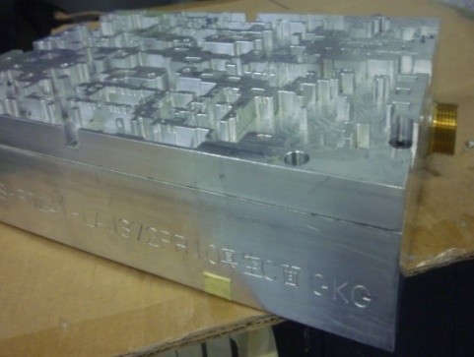
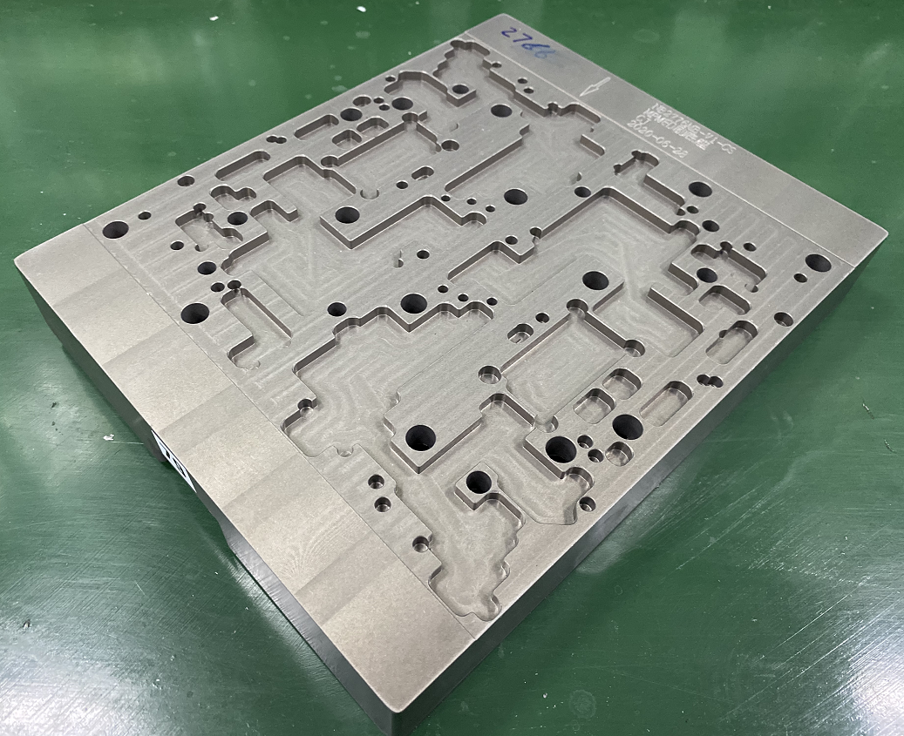
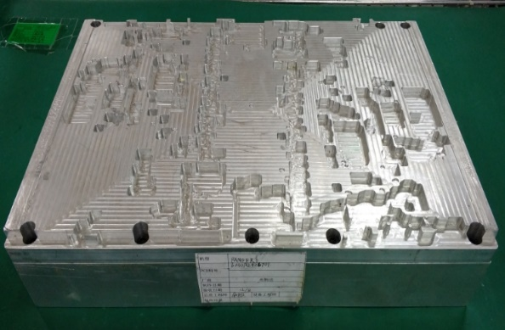
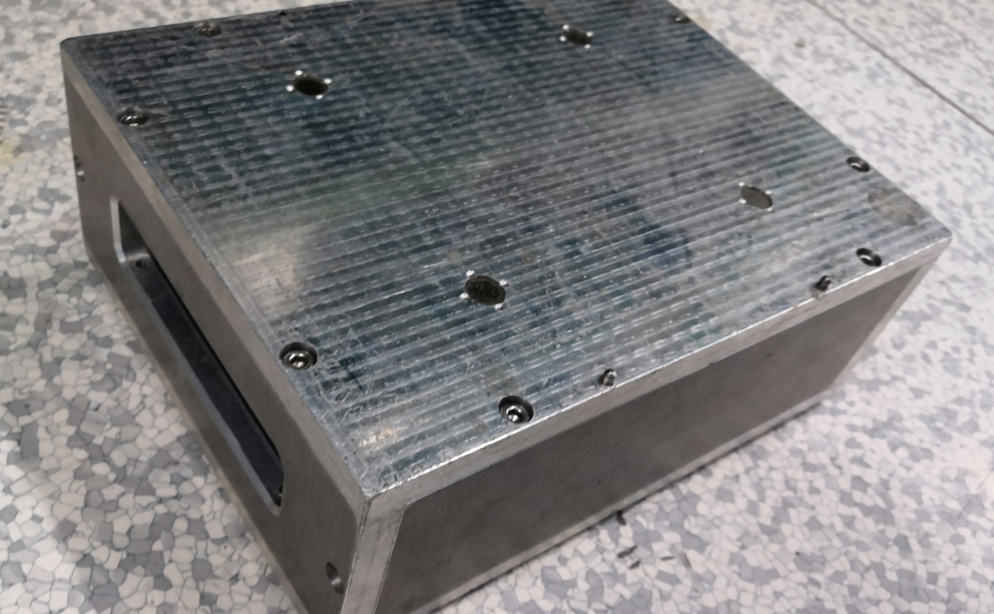
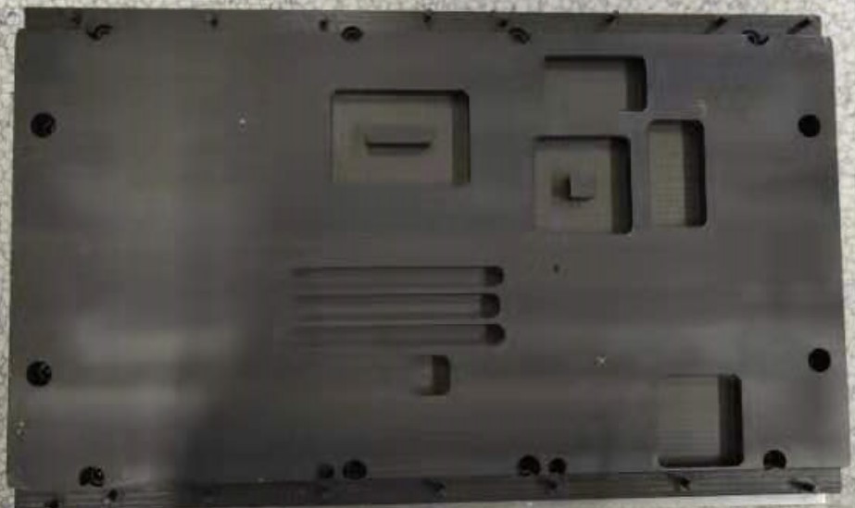
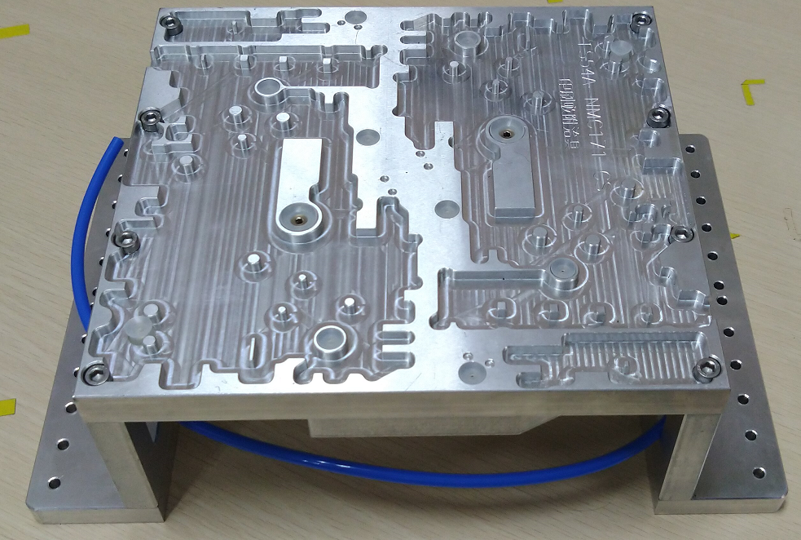
Customer Pictures Of Support Block
Vacuum Block
Support Block
Compal KS
HuaQin
Inventec CQ
LCFC
Pega CQ
Pega SZ

Slide 59
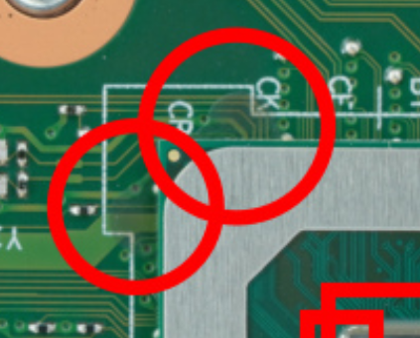
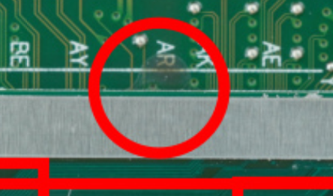
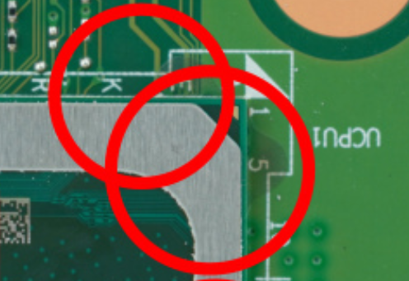
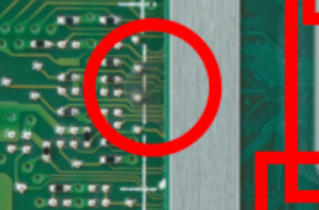
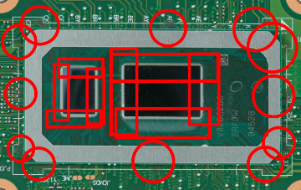
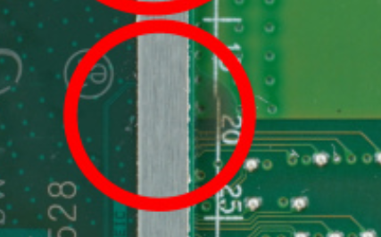
Lenovo X390/LTS Tear Down Picture

Slide 60
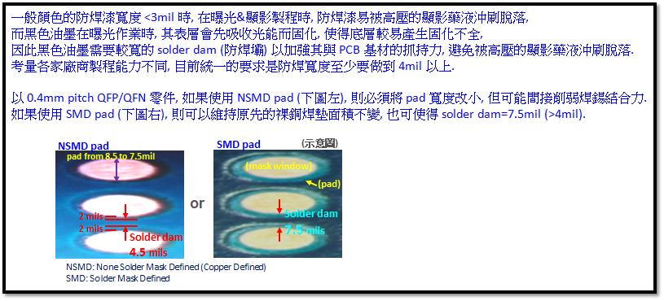
Compal’s Learning About Why Black SM Not Easy To Have Good MD Pad In Small Pitch
During PCB mfg process, the SM (Solder Mask) will be easier washed away by high pressure development-fluid, if the solder mask dam < 3mil.
When it comes to black solder mask, during light exposure process, the top surface of the SM will absorb more light energy thus cured quickly, lead to the SM bottom side still soft at the end of the process, weakening the capability of SM dam to hold itself on top of the PCB surface. The SM dam will be easily washed way at the following process ‘high pressure development-fluid wash’.
So in our design guideline, we request at least 4mil SM dam width for black SM PCB. It limited the possibility to have MD pad in small pitch BGA because MD pad have much narrow SM dam compare to SMD pad

